Slide 1

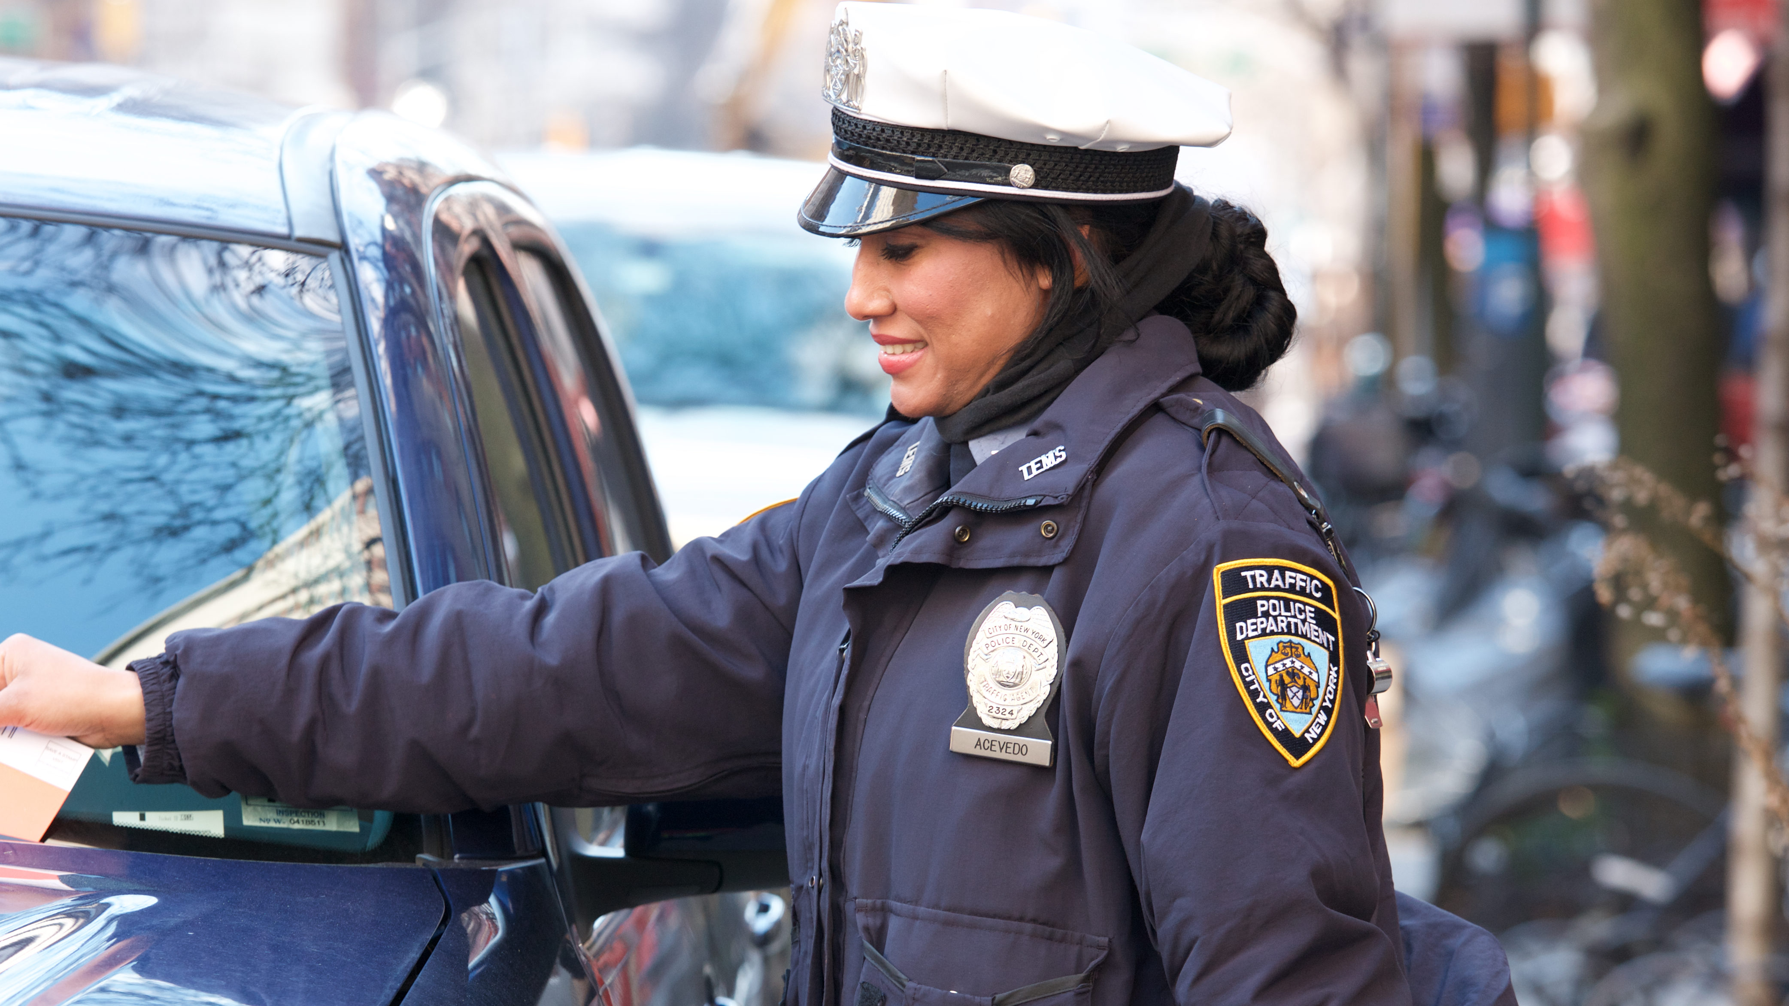
NYC Open Parking and Camera Violations
CIS 3210 Group Project by Diana Konsevych, Dinara Ibotova, Beelen Guzman, and Ray Kim.
Notes:
Must be around 3 minutes

Slide 2
Objective:
Analyze parking violation data from NYC Department of Finance (DOF) in the year 2024 identify patterns, trends, and insights of the most prevalent car violations. Our goal is to address and analyze parking violations and the issuing agencies while providing recommendations on improving traffic safety.

Slide 3
Methodology
Data provided by Department of Finance
Size: over 122 million rows, but we only used 1 million for our analysis (why in challenges) – json to csv file
To clean data, we used dropna(), .rename(columns={}). For the questions, we used groupby(), nlargest(), and filtered data
Tools and Software: Python and relevant libraries (e.g., requests, pandas, seaborn), Deepnote, Jupyter Notebook.

Slide 4
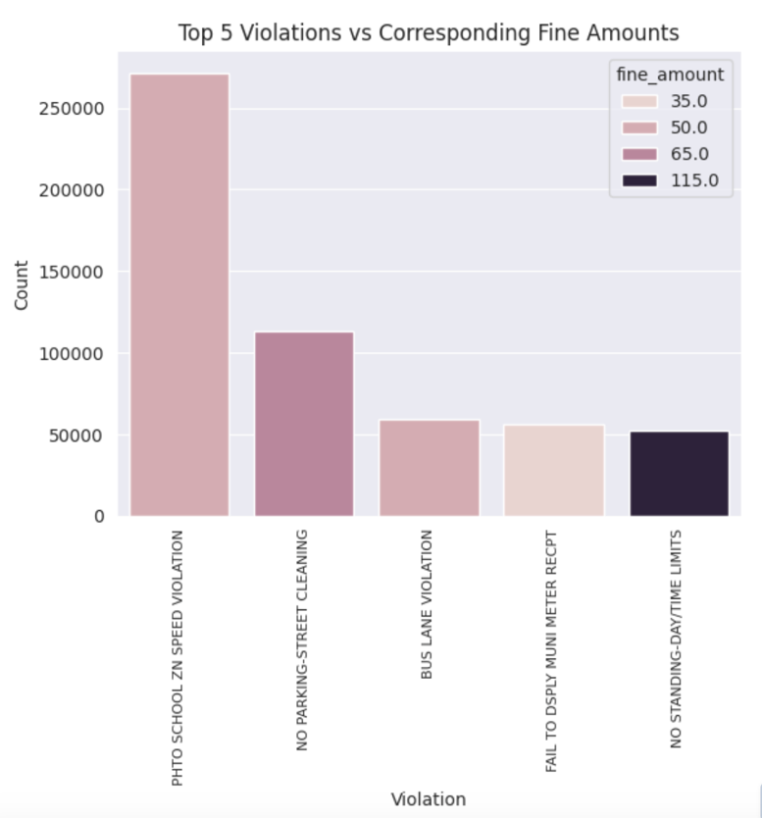
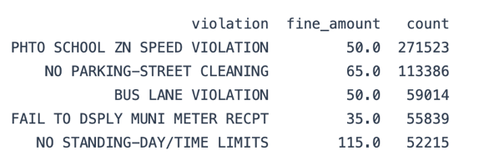
Key Findings
The most common violations are not necessarily the most expensive.
The most expensive among the top 5 most common violations (no standing - day time limits) is the least common.
BUT the small variance in fine amount does not influence the number of violations per category.
Notes:
(DK) One of our key interests was to find …
Muni meter – parking meter receipt
What are the top 5 violations and their corresponding fine amounts?
The analysis included grouping by violation and fine amount, as well as using nlargest() to find the top 5.
Insights and Discussion: The top 5 violations are (in descending order): Photo school zone speed violations with the fine amount of $50, No parking - street cleaning with the fine amount of $65, Bus lane violations $50, Fail to display muni meter receipt (muni meter receipt refers to the parking meter receipt) with the fine amount of $35, No standing - day time limits with the fine amount of $115. So, as you can see, the most common violations are not necessarily the most expensive. In fact, the most expensive among the top 5 most common violations (no standing - day time limits) is the least common. However, the fee amounts also do not decrease with the amount of violations per category. What does that mean? It is reasonable to infer that there is no apparent correlation between the fine amount and reduction in violations. In other words, a rudimentary increase in the fees will not necessarily reduce the prevalence of a given violation. In our opinion, the price increase might have to be drastic to be effective.
How can this data be used? It can be used to lobby for significantly higher fine amounts under the premise that small fines do not seem to do much to decrease the number of violations.
Comparison with initial hypothesis: I expected the number of violations to decrease with fine amounts. The small increase/decrease in fine amounts does not seem to influence the violation count per category.
Limitations of the analysis: as for our whole project, we are only using a million rows of data out of over 122 million because that is all our computers can handle. So, the results may not be a 100% representative of reality.

Slide 5
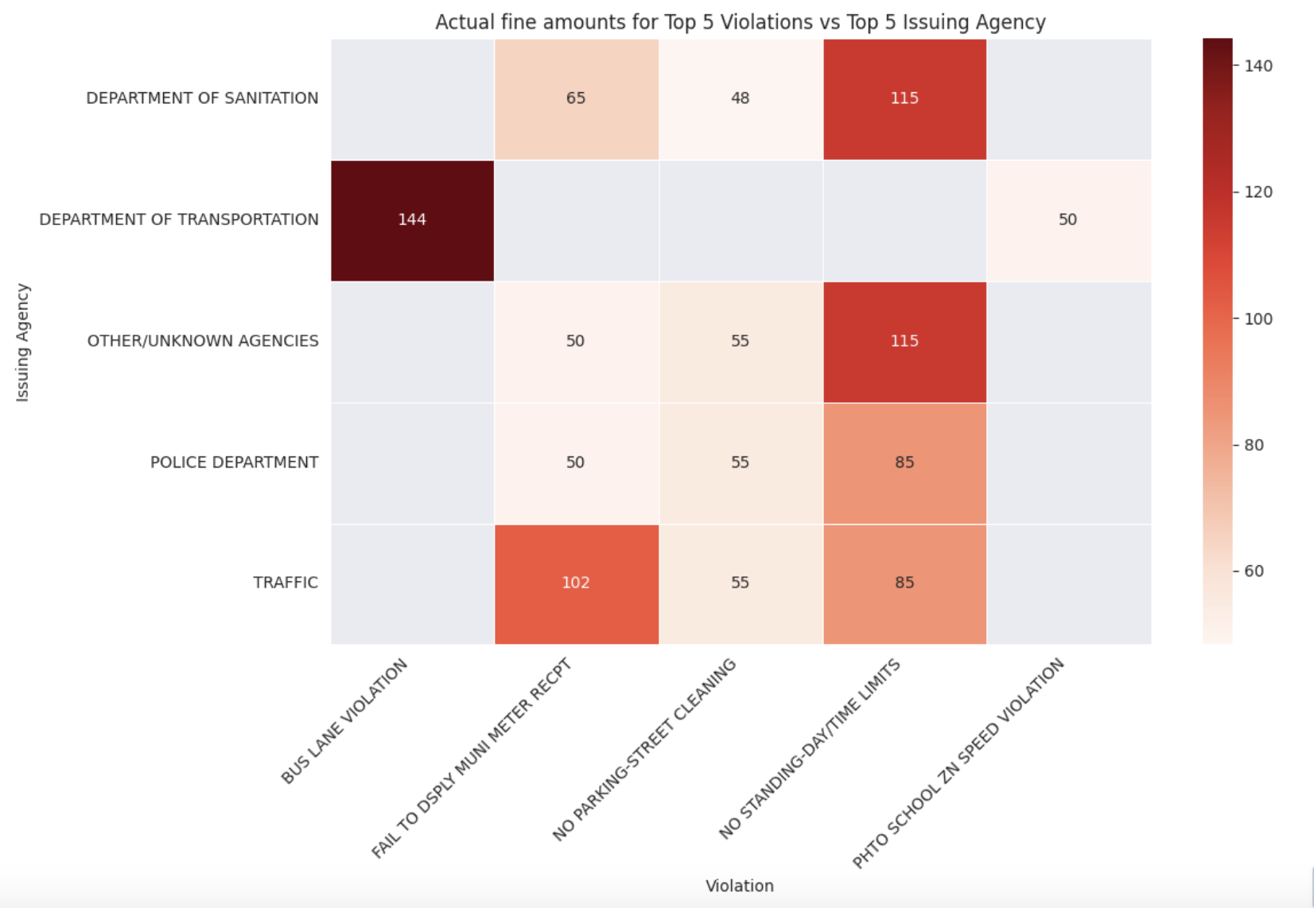
Key Findings (continued):
The Department of Transportation has the highest fine amount for "Bus Lane Violation" (144).
"Fail to Display Muni Meter Receipt" fines across multiple departments vary widely.
The Department of Sanitation gives a significant fine (115) for "No Standing/Daytime Limits".
Notes:
(DI)

Slide 6
Challenges and Solutions:
The size of the dataset made it difficult to refresh the data each time, so we had to save the API's result into a csv file which also kept our data consistent.
Due to the violation time's formatting issues, we had manipulation/analysis issues. In the end we had to scrap visuals pertaining to violation time.
Violations from the same county were being bucketed into different labels due to naming errors. For example, one county could have three different variations: Q, QNS , Qns, Qn which all means Queens County. Our solution was to create a function that renamed the county based off their current labels.
Notes:
(Beelen)

Slide 7
Conclusion
Lower cost of violations have a higher frequency (suggest weaker enforcement)
Less frequent violations turn out to have higher fine (suggest less to occur)
High # of fine from Department of Sanitation suggest need to improve on regulations
Recommendation:
Access to additional Data: Having access to drivers age & vehicle type will help identify the type of violation are most likely to receive.
Increasing enforcement -> reduce frequency
By addressing these findings, there can be suggestions to improve data collection, address awareness, and improve on regulation to make changes.
Notes:
To give an overview, we found 3 main findings...

Slide 8
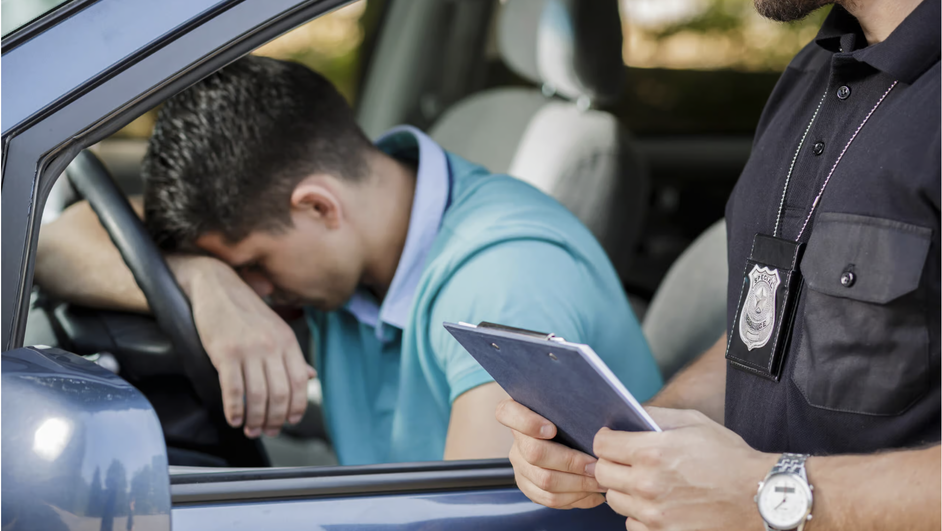
Thank you! Q&A

Slide 9
Questions Addressed in the Overall Report:
Which license type received the most tickets/accidents?
What are the top 5 violations and their corresponding fine amounts? - Show
How are the top 5 violations distributed among the top 5 licenses with most offenses?
Which county received the most tickets?
Which issuing agency gives the most violation tickets?
Which day of the week has the most violations? -Show
How do fine amounts vary across issuing agencies and violations? - Show

Slide 10
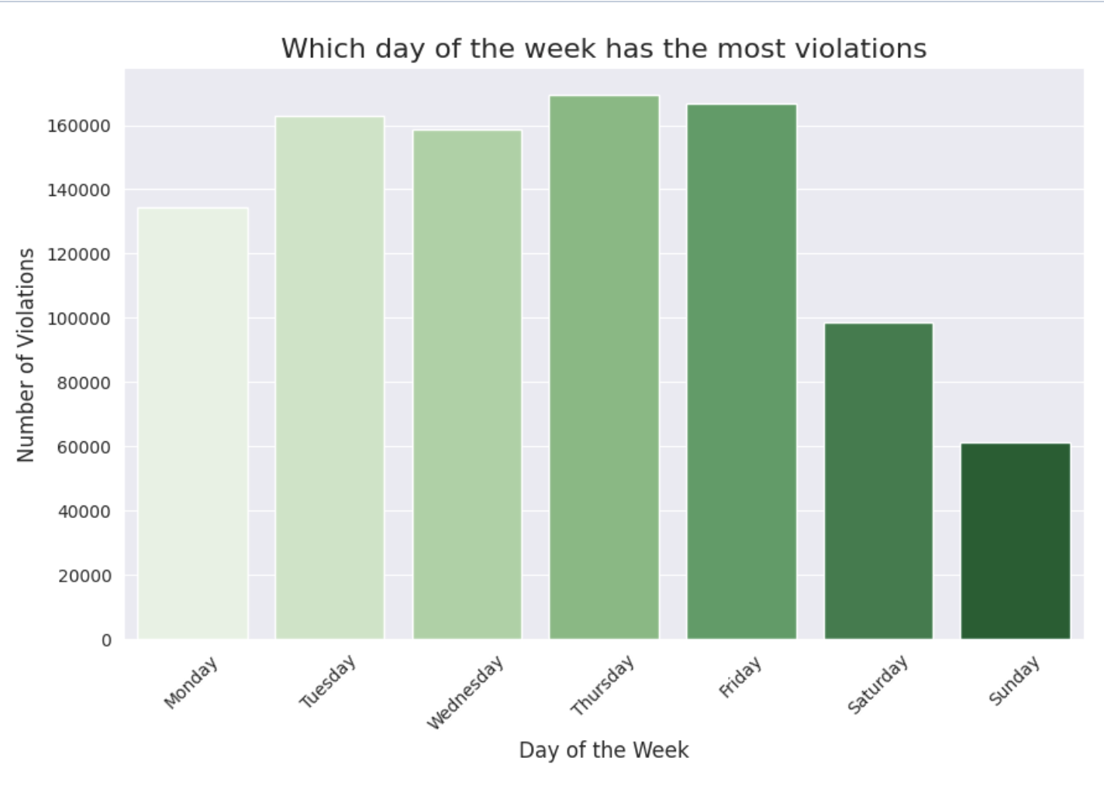
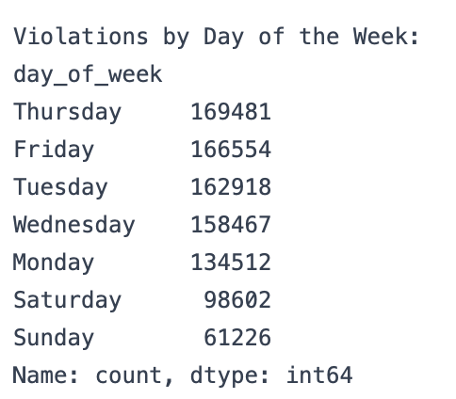
Which day of the week the most violations occurred

